Slide 1
VSC HPC Introduction
ICTS KU Leuven VSC staff: Ehsan Moravveji Mag Selwa Wouter van Assche Geert Jan Bex (Uhasselt) Jan Ooghe

Slide 2

Material
Everything is on Github: https://hpcleuven.github.io/HPC-intro/
Video Recordings - Scan the QR code - Recommended videos: ~ 2 hrs - Optional videos: ~1 hr
2

Slide 3

What is High Performance Computing?
Using supercomputers to solve advanced computation problems
Reduce the computation time from days, years, decades, or centuries to minutes, hours, days, or weeks
The key is parallelism
Notes:
HPC is about techniques of boosting the efficiency of your codes and computation to enhance the compute performance as compared with a similar workflow on a typical laptop or workstation.

Slide 4

In practice, it is more like …
The concept is simple: Parallelism = employing multiple processors for a single problem
Notes:
In practice, there is a pool of computing resources made available to you which are waiting to receive instructions from the user. The nodes are all inter-connected, which means you can employ more than one node in a specific compute task, and the nodes within the task can communicate with one another at runtime, whenever needed.

Slide 5


Outline
VSC
Tier-2 Clusters
Storage
Login Nodes & MFA
Connection Setup
PuTTY
Terminal
NX
About
Setup
File Transfer with Filezilla
Open Ondemand Software Stack
Starting to Compute
Conda Package Management
Python
R
Worker Framework
Demo: Test for yourself

Slide 6

VSC (Vlaams Supercomputer Centrum)

Slide 7




















VSC PARTNERSHIP
A n t w e r p e n
O o s t
V l a a n d e r e n
Supported by
W e s t
V l a a n d e r e n
L i m b u r g
V l a a m s - B r a b a n t
B r u s s e l
vscentrum.be
7
Notes:
VSC is a partnership between 5 major universities and associations in Flanders, namely … and is spread among 4 sites. VSC is sponsored by the flemish research organization FWO. The idea is that the academics (scientists, students) and industrial partners in Flanders have an easy access to compute and storage facilities. Hence any individual with a single VSC account is eligible to compute on any cluster/site that he/she deires

Slide 8







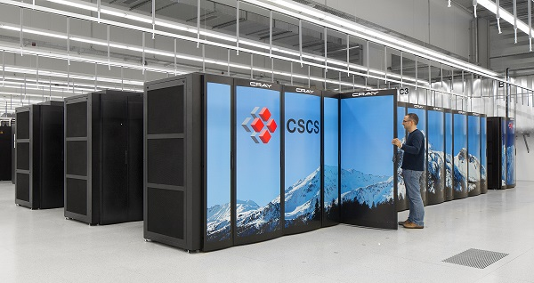


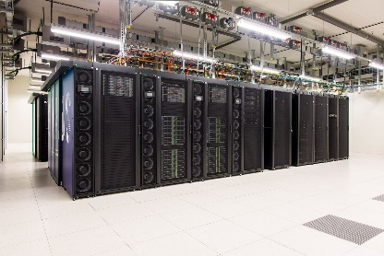





VSC HPC Environments
Tier-0
Tier-1
Hortense
Tier-2
STEVIN | HYDRA | HOPPER/LEIBNIZ | GENIUS/WICE
8
Notes:
All VSC users can use Tier-2 clusters from any site they desire.
If you still require more compute resources which does not fit into available Tier-2 limits, you can apply for Tier-1 compute time.
Even if Tier-1 level is insufficient, you can apply for Tier-0 level where Belgium is also part of a European consortium.

Slide 9

www.vscentrum.be
Documentation! Answers >80% of your questions and access to account page
Very rich suite of courses every academic year

Slide 10

10

Slide 11
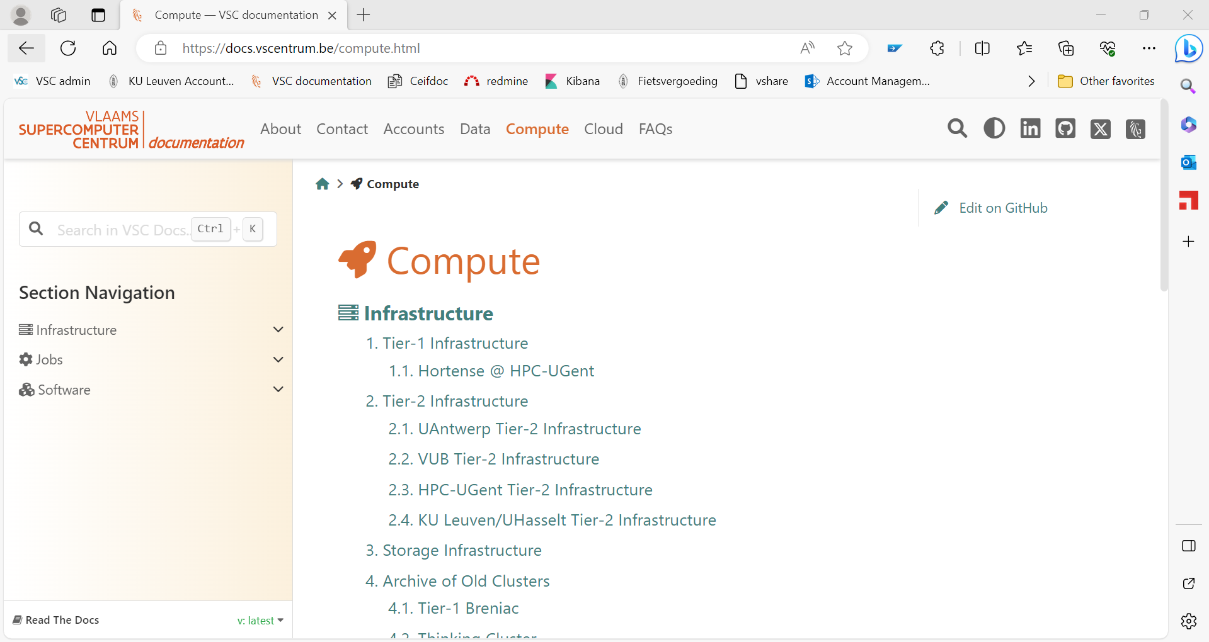
Search you keywords here; e.g. qsub
Notes:
All items are indexed
There is a power search engine there.
Just put a keyword there.

Slide 12
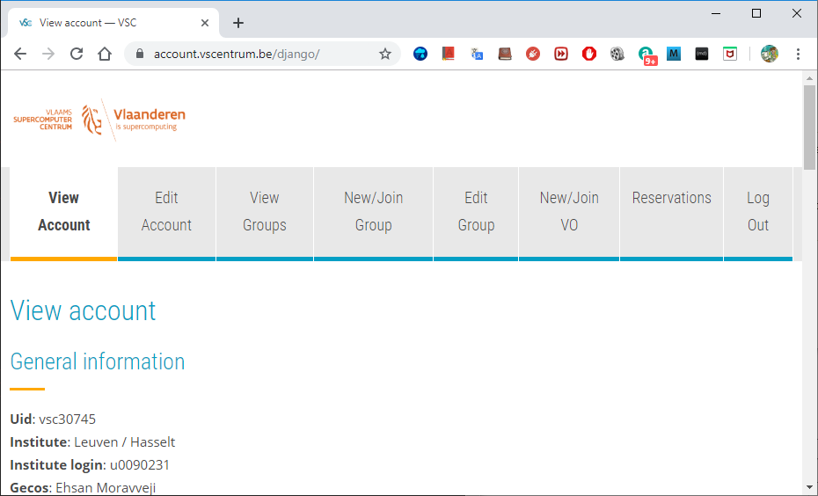
To manage your VSC account: account.vscentrum.be
Upload more SSH public keys
Upload SSH Key Request account
Create or request to join a new group
Moderate your own groups (add/remove users)

Slide 13
Support and Services
Basic support
Helpdesk (hpcinfo@kuleuven.be)
Monitoring and reporting
Application support
Installation and porting
Optimisation and debugging
Benchmarking
Workflows and best practices
Training
Documentation and tutorials
Scheduled trainings / workshops
On request workshops
One-to-one sessions

Slide 14
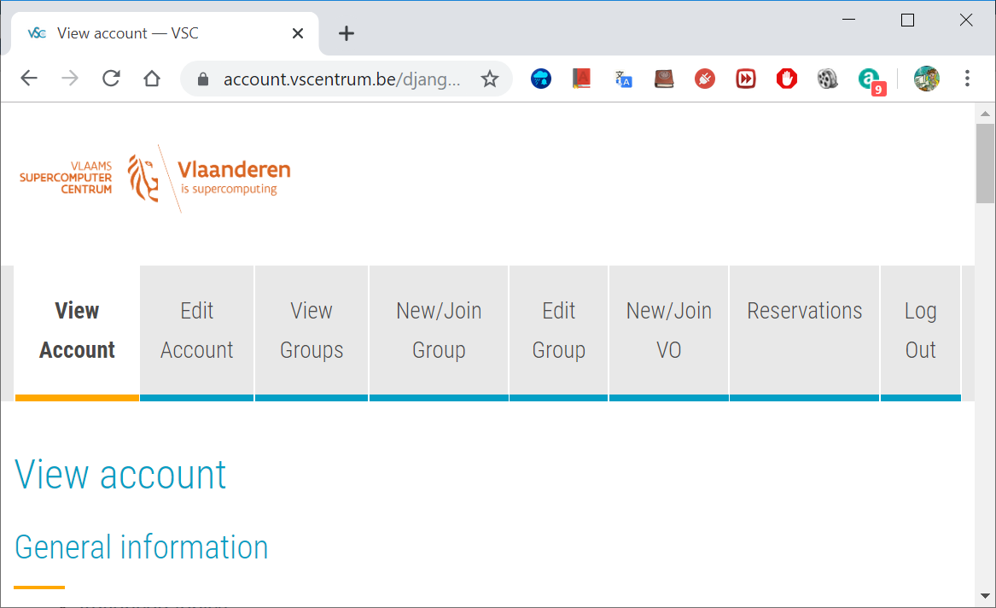

Become a VSC user
Create a secure (4096 bit) SSH key pairs Upload it on the account page: www.account.vscentrum.be
You need to request a VSC account Normally processed swiftly
Request introductory credits (2M free credits for 6 months)
Request project credits (for supervisors and project leaders) You need to create a VSC group Add users to the group to give them access to use credits Fill out the request form
Extra storage requests Scratch extension: free of charge Staging fileset: 20 € per TB per year
All service costs (compute and storage) are all explained Go to ICTS service catalogus: https://icts.kuleuven.be/sc Click on High Performance Computing (NL/EN)
14

Slide 15
Infosessions:
Containers
Notebooks
VSC training
Matlab (Supercalculator)
Matlab Programming
Linux for HPC
Linux scripting
Introductory
Intermediate
Advanced
Specialized track
Make intro
Linux tools
Linux
HPC intro
CMake intro
Version control systems
C
Python as a second language
Python: System programming
Scientific Python
Python for Software engineering
Python for data science
Python for machine learning
worker/atools
C++ for scientific computing
Julia good bad ugly
Fortran for programmers
High Performance Python
Debugging techniques
OpenMP
?
MPI
Code optimization
Stay up-to-date https://www.vscentrum.be/en/education-and-trainings

Slide 16
To Acknowledge VSC in publications
Why?
At KU Leuven
a contractual obligation for the VSC
helps VSC secure funding
you will benefit from it in the long run
add the relevant papers to the virtual collection "High Performance Computing" in Lirias
In het nederlands
In English
De rekeninfrastructuur en dienstverlening gebruikt in dit werk, werd voorzien door het VSC (Vlaams Supercomputer Centrum), gefinancierd door het FWO en de Vlaamse regering – departement EWI.
The computational resources and services used in this work were provided by the VSC (Flemish Supercomputer Center), funded by the Research Foundation - Flanders (FWO) and the Flemish Government – department EWI.

Slide 17
Tier-2 Clusters

Slide 18
Compute nodes
What is a Cluster?
A cluster is comprised of many powerful interconnected compute nodes
Some Terminology:
Infiniband interconnect
 | What | Components
Cluster | The primary part of a cluster are its many powerful interconnected compute nodes. | Compute nodes Login nodes Storage space Interconnect Network …
Node | A single computer connected with other nodes via an interconnect network | CPU, Storage, Memory, …
CPU | Processing Component of a computer, also called the processor. | Controllers, Cache Memory, Processing Cores
Core | Processing element of the CPU. | Control Unit, Arithimic-Logic Unit, Memory.
Login nodes
Storage
18

Slide 19


Tier-2 Clusters @ KU Leuven
Genius (since 2018) 250 nodes: 8,936 cores
wICE (since 9/2022) 186 nodes; 13,392 cores
19

Slide 20

wICE (since 9/2022) 186 nodes; 13,392 cores
Superdome
SkyLake
Cascade Lake
86+10 nodes
3456 cores
20 nodes
720 cores
120 nodes
4320 cores
2 nodes
72 cores
2x Intel Skylake
18 cores
2x Intel Skylake
18 cores
2x Intel Cascadelake
18 cores
2x Intel Cascadelake
18 cores
AMD
192 GB
RAM
768 GB
RAM
4 x NVIDIA P100
192 GB
RAM
8 x NVIDIA V100
IB EDR
IB EDR
Belnet
KU Leuven
Ethernet
Ethernet
IB
IB EDR
IB EDR
NAS
70 TB
HOME
DATA
2 nodes
72 cores
2 nodes
72 cores
Lustre
Scratch
DDN
1,2 PB
2x Intel Skylake 18 cores
2x Intel Skylake 18 cores
NFS
Archive
1 PB
1 x NVIDIA
P600
384 GB
RAM
384 GB
RAM
Watch out with login scripts !
login-genius.hpc.kuleuven.be
Genius
20

Slide 21

Tier-2 Cluster - wICE
Compute nodes
Large memory nodes
GPU nodes
5x IceLake 72c 2048 GB
4x IceLake 72c 512 GB
4 A100 SXM4 80GB
Interactive nodes
No Dedicated Login Nodes
172x IceLake 72c 256 GB
5x IceLake 64c 512 GB
1 A100 80GB
21

Slide 22
Tier-2 Cluster - wICE
Type of node | CPU type | Inter-connect | # cores | installed mem | local discs | # nodes
Icelake | Xeon 8358 | IB HDR-100 | 72 | 256 GB | 960 GB | 172
Icelake large mem | Xeon 8358 | IB HDR-100 | 72 | 2048 GB | 960 GB | 5
Icelake GPU | Xeon 8358 4xA100 SXM2 80GB | IB HDR-100 | 72 | 512 GB | 960 GB | 4
Icelake Interactive | Xeon 8358 1xA100 SXM2 80GB | IB HDR-100 | 64 | 512 GB | 960 GB | 5

Slide 23
Storage

Slide 24
Overview of the storage infrastructure
Your files are owned only by you. Other VSC users have no permission to read/write/execute your files (POSIX)
A VSC account has 3 default storages (free of charge)
$VSC_HOME
$VSC_DATA
$VSC_SCRATCH
You can additionally request staging storage
Different storage volumes have different:
mount point
size and performance
use case
backup and maintenance policy
More info on ICTS Service Catalog (EN/NL)

Slide 25
Storage
Request form for extra storage
More information
Example
$ myquota
file system $VSC_HOME
Blocks: 1479M of 3072M
Files: 12934 of 100k
file system $VSC_DATA
Blocks: 12G of 75G
Files: 1043k of 10000k
file system $VSC_SCRATCH
Blocks: 15M of 1.5T
Do NOT use /tmp It is only 10 GB and is reserved for the OS and root processes Your application can crash if using /tmp
You are automatically logged into your home folder upon login. Make sure you immediately go to your other storages, e.g. $ cd $VSC_DATA
Always check your storage balance using myquota command
25

Slide 26
Storage | home folder
Env. Variable | $VSC_HOME
Filesystem Type | NFS
Access | Global
Backup | Hourly, daily, weekly (until last month) inside the .snapshot folder.
Default Quota | 3 GB
Extension | Not possible
Usage | Only storing SSH keys, config files
Remarks | - Stay away from using it - Can easily overflow: + Your jobs may crash + Login issues
Storage
home
data
scratch
node scratch
staging
archive
26

Slide 27
Storage | data folder
Env. Variable | $VSC_DATA
Filesystem Type | NFS
Access | Global
Backup | Hourly, daily, weekly (until last month) inside the .snapshot folder.
Default Quota | 75 GB
Extension | On purchase
Usage | Your data, code, software, results
Remarks | Permanent storage for initial/final results Not optimal for intensive or parallel I/O
Storage
home
data
scratch
node scratch
staging
archive
27

Slide 28
Storage | scratch folder
Env. Variable | $VSC_SCRATCH
Filesystem Type | Lustre
Access | Global
Backup | delete after 30 days from last access
Default Quota | 500 GB
Extension | Free
Usage | Intensive, parallel I/O, temporary files
Remarks | Recommended storage for all jobs Copy scratch files to VSC_DATA or local storage after jobs are done Deleted files cannot be recovered
Storage
home
data
scratch
node scratch
staging
archive
28

Slide 29
Storage | Node scratch folder
Env. Variable | $VSC_SCRATCH_NODE
Filesystem Type | Lustre
Access | On compute node, only at runtime
Backup | None
Default Quota | 591 GB
Extension | Read about beeOND
Usage | Temporary storage at runtime
Remarks | Fastest I/O, attached to the node Is cleaned after job terminates Copy the data to your home, scratch, or staging before job ends
Storage
home
data
scratch
node scratch
staging
archive
29

Slide 30
Storage | Staging folder
Path | /staging/leuven/stg_000XX
Filesystem Type | Lustre
Access | On demand, only Tier-2@KUL
Backup | None
Default Quota | None
Extension | On purchase, from 1 TB
Usage | Permanent; share with a group
Remarks | Accessible from login/compute nodes Fast, parallel I/O
Storage
home
data
scratch
node scratch
staging
archive
30

Slide 31
Login Nodes & MFA

Slide 32

Accessing a Cluster
Compute nodes
Firewall
Infiniband interconnect
Link to other VSC sites
Scientist
SSH Authentication
Administration - queue system, job scheduler, user management,…
Login nodes
Service nodes
Storage
32

Slide 33
Using Login Nodes
To develop code
To check your storage and credit balance
To manage jobs (submit, check status, debug, resubmit, …)
To move data around
within VSC: use data, scratch, staging, archive
outside VSC: copy/sync from/to your local storage
To pre-process or post-process your data/jobs
To visualize your data
To share files/folders
Tips
Warning
Do NOT execute heavy-lifting tasks (core, memory)
Login nodes are shared resources
Instead, submit jobs: e.g. Compile your software on compute nodes. Check $ slurmtop to see how busy the cluster is
33

Slide 34
Login Hosts on Different Machines/partitions
Windows | Linux/Mac:
PuTTY Terminal NX | Terminal NX
This is not a computationa GPU – single precision only – visualization purpose
To login, you need an active VSC number and a hostname $ ssh –X vscXXXXX@<hostname>
Cluster / Partition | <hostname> | Remark(s)
Genius | login.hpc.kuleuven.be | Recommended
 | login{1,2}-tier2.hpc.kuleuven.be | No GPU
 | login{3,4}-tier2.hpc.kuleuven.be | Nvidia Quadro P6000
wICE |  | Accessible only via Genius

Slide 35
Connection Setup
PuTTY
Terminal

Slide 36
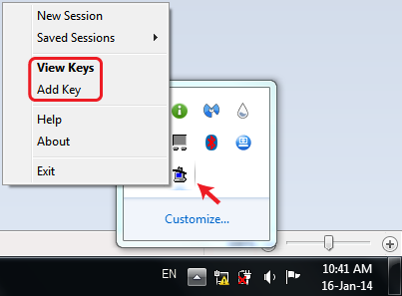
Activate Your SSH Agent
(Windows only)
When you install PuTTY, the agent called Pageant is automatically installed
Open Pageant; it hides inside your bottom-right tray
Click on “Add Key” and brows to your private key(s) folder
After choosing a key, you are asked for a passphrase
If successful, agent always remembers your SSH keys and Certificates (Multi-Factor Authentication)
36

Slide 37
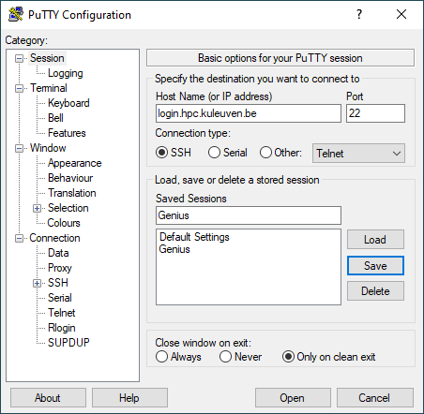
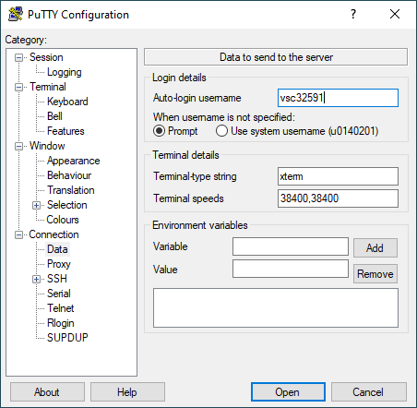
Setup PuTTY
Host Name: login.hpc.kuleuven.be
(Windows only)
1
5
2
3
4
37

Slide 38
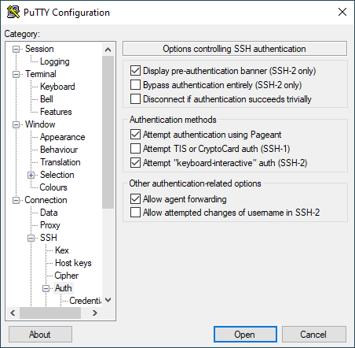
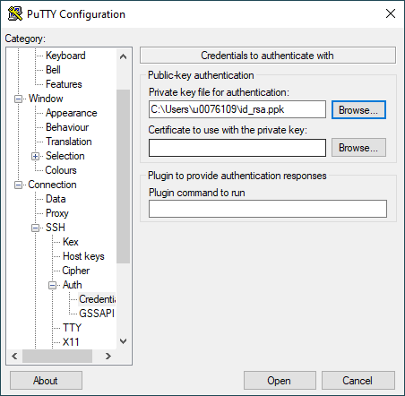
Setup PuTTY
(Windows only)
9
7
8
6
38

Slide 39
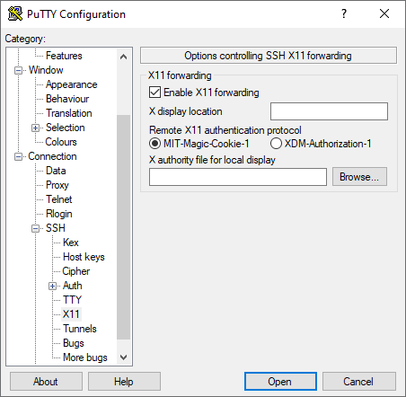
Setup PuTTY
(Windows only)
11
10
39

Slide 40
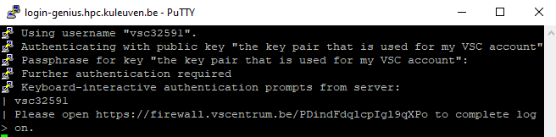
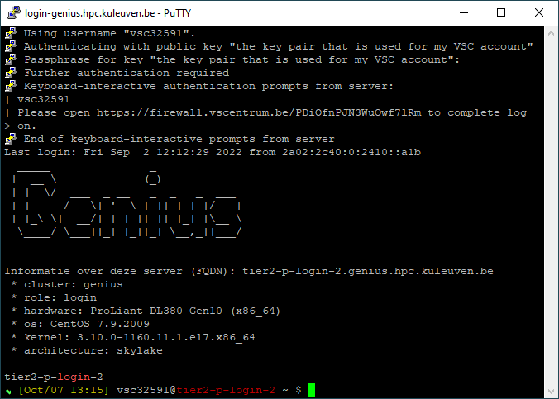
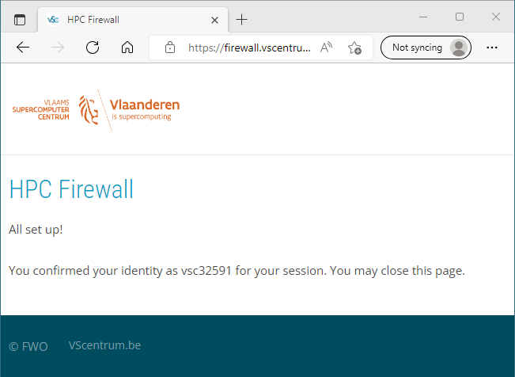
Setup PuTTY
If PuTTY asks for password, exit immediately, and check the path to your private key. Else you will be blocked for 24h.
(Windows only)
12
13
40

Slide 41
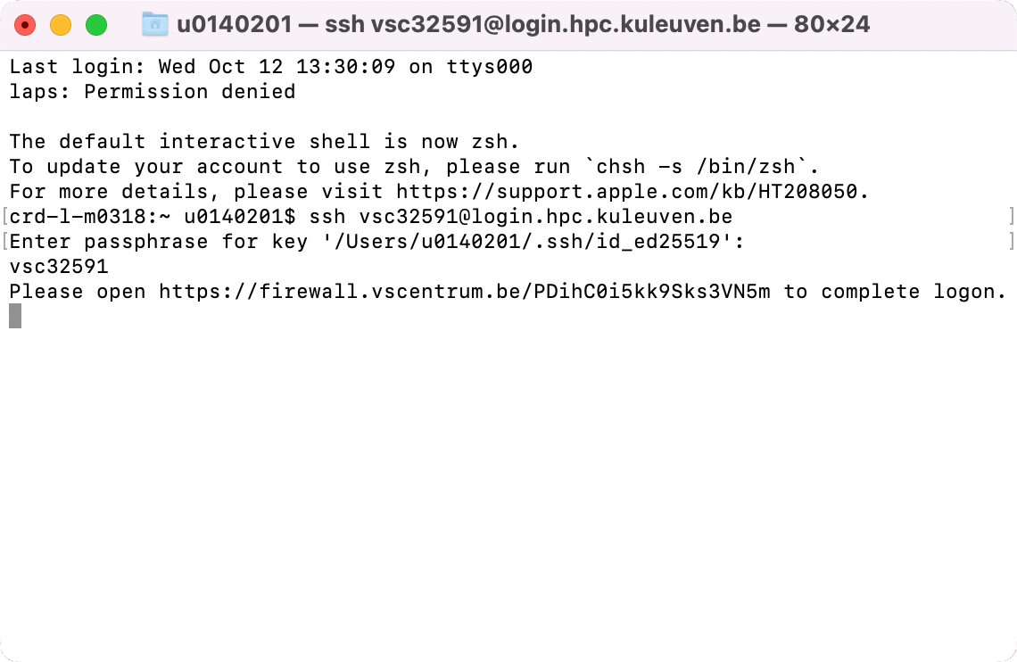
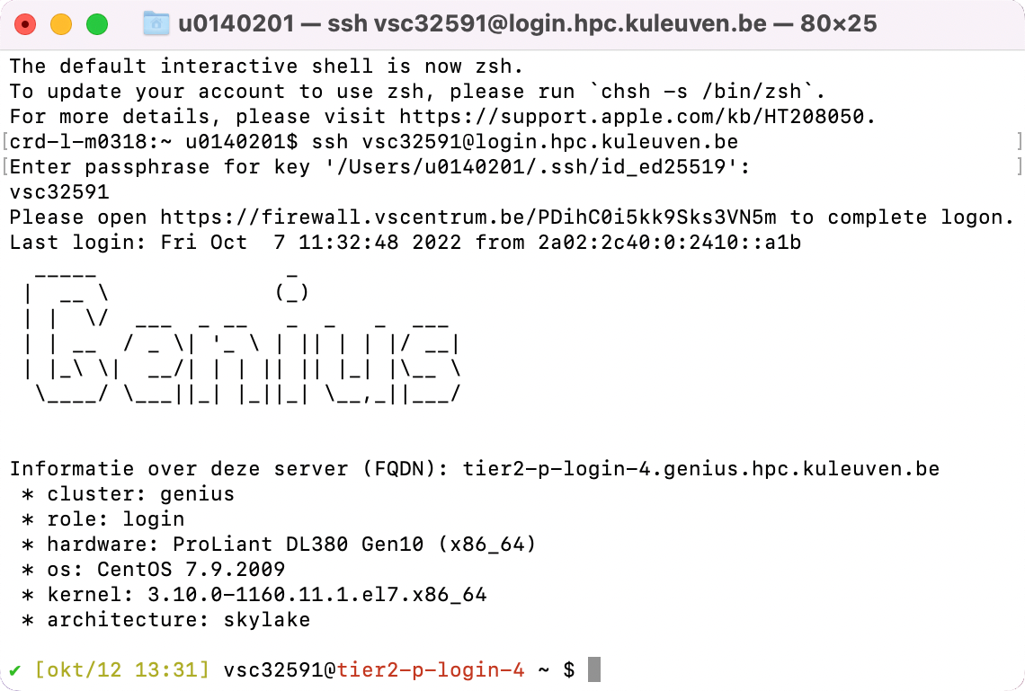
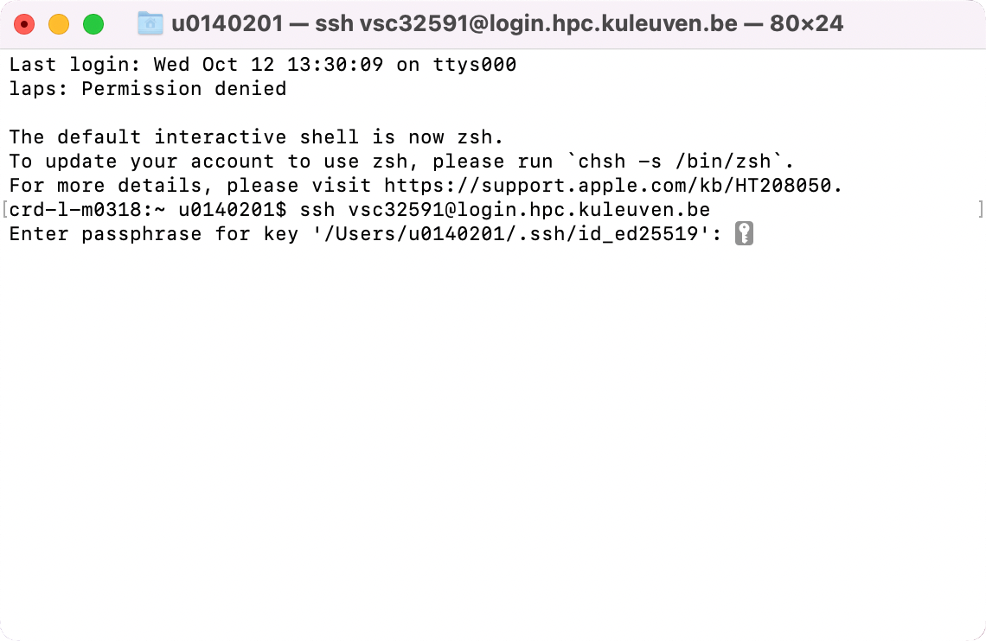
Connecting via Terminal
Host Name: login.hpc.kuleuven.be
(Linux and Mac)
Use ssh to connect: $ ssh vscXXXXX@<host_name>
If key not found: $ ssh -i </path/to/keyfile> ...
If asked for password, please stop connecting and contact support, otherwise after a few attempts you will be blocked for 24h.

Slide 42
Connecting via Terminal
Host Name: login.hpc.kuleuven.be
(Linux and Mac)
With SSH Agent
Check your SSH Agent. Is your SSH key found? $ ssh-add –l
If your SSH Agent is not running: eval $(ssh-agent)
If your key is not found, add it to the Agent: $ ssh-add </path/to/keyfile>
Use ssh to connect: $ ssh vscXXXXX@<hostname>

Slide 43
NX
About
Setup

Slide 44
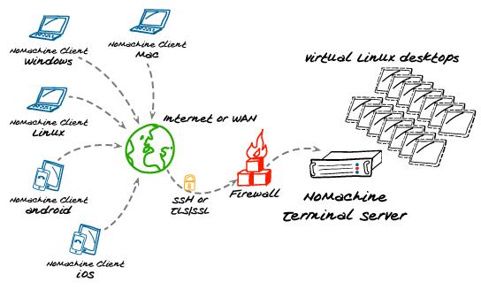
NX – The Graphical Login
NX is a graphical remote desktop server
login to VSC
start a virtual Linux instance(s)
Client: NoMachine
Configuration Guide
Using OpenSSH key Convert your key

Slide 45
Advantages of NX
Graphical login
A session stays alive/active even if you close your client (e.g. laptop)
Resume a session, and immediately keep working where you left off
More interactive jobs
Available apps:
Internet browser, terminal, …
Text editor, PDF reader, Image viewer, …
Matlab, RStudio, SAS
Remark: NX is shared among tens of users Do not compute/test your code there Instead, submit jobs from NX to compute nodes

Slide 46
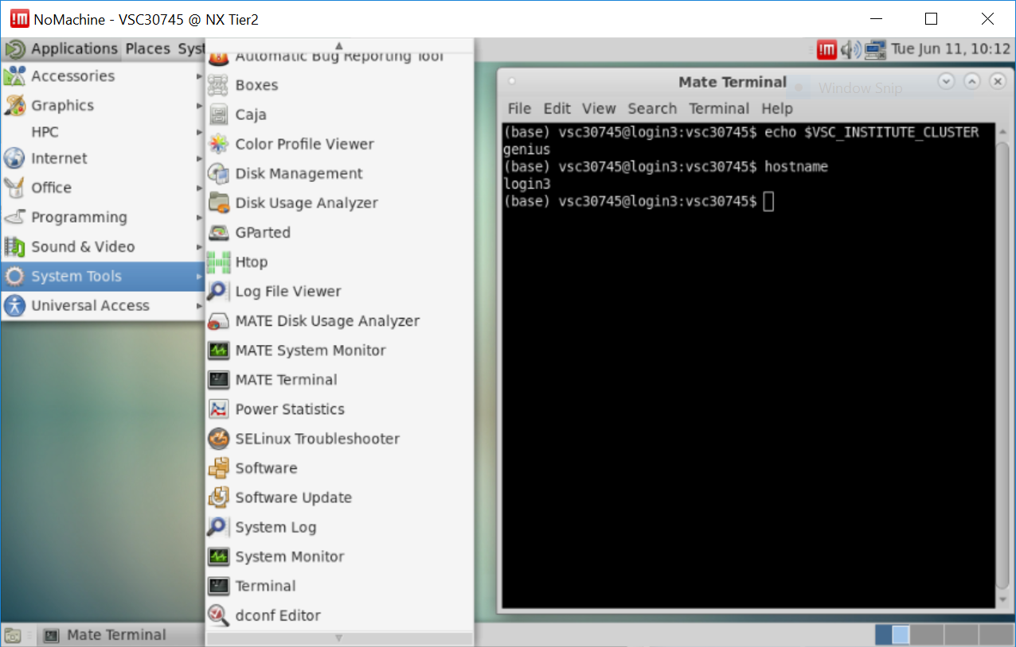
NX virtual desktop
NX server is hosted on two Genius login nodes

Slide 47
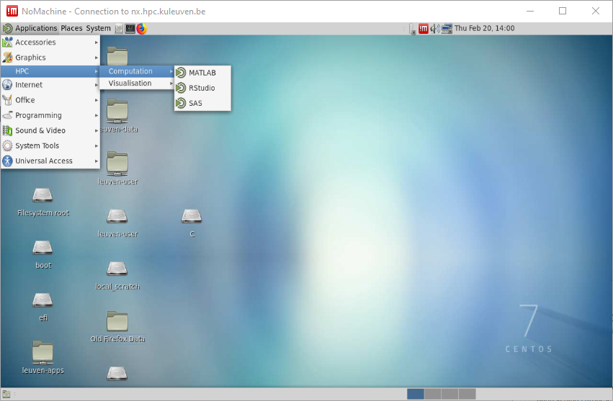
NX is a graphical login node
A new session stays active for long
Rich suite of applications; e.g. Terminal, Firefox, text editor, Matlab, RStudio, SAS etc.
NX is a shared, login-node. Please do not compute on NX.
NX server is attached to Genius. Jobs submitted from NX will appear in Genius queue
47

Slide 48
NX: available software
Accesories: Gedit, Vi IMproved, Emacs (dummy version), Calculator
Graphics: gThumb (picture viewer), Xpdf Viewer
Internet: Firefox
HPC: Computation: Matlab (2018a), RStudio, SAS
Visualisation: Paraview, VisIt, VMD
Programming: Meld Diff Viewer (visual diff and merge tool)
System tools: File Browser, Terminal
Additionally: Gnuplot (graphing utility), Filezilla (file transfer tool), Evince (PDF, PostScript, TIFF, XPS, DVI Viewer)
Software launched through modules from Terminal.

Slide 49
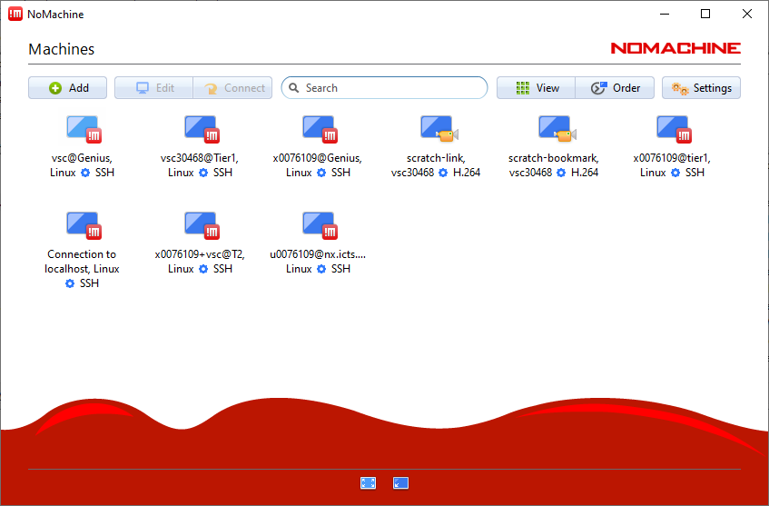
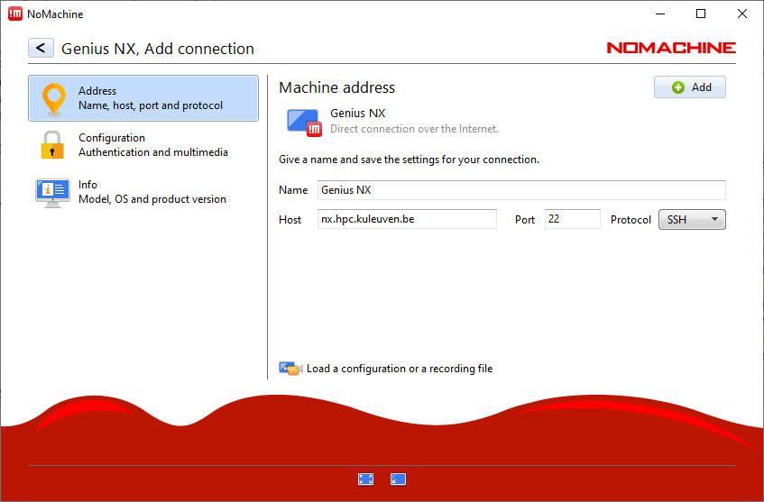
Setup NX
1
2
4
3
Host: nx.hpc.kuleuven.be
49

Slide 50
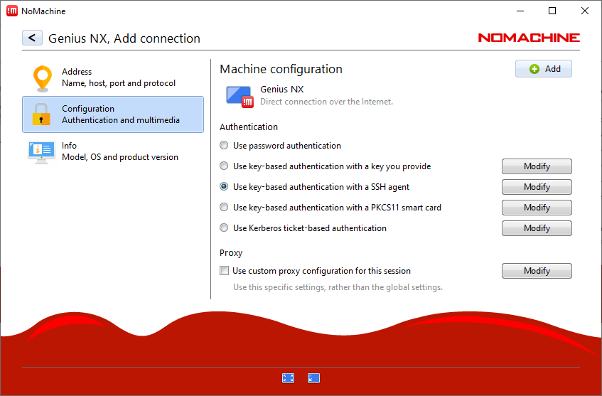
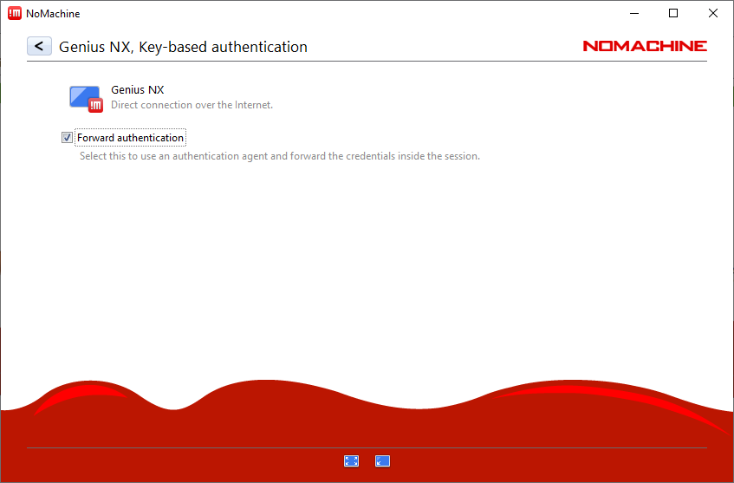
Setup NX
6
5
4
3
50

Slide 51
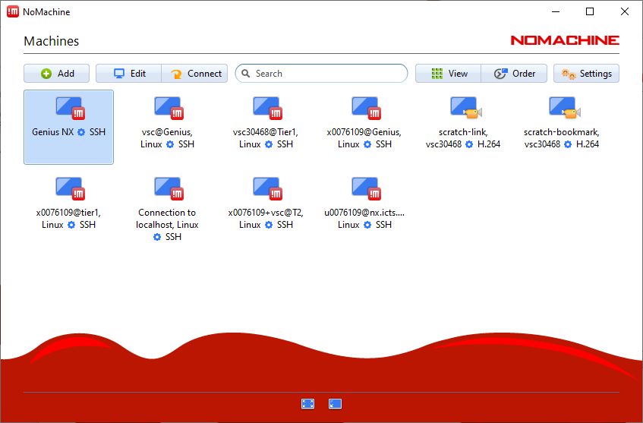
Setup NX
7
8
51

Slide 52
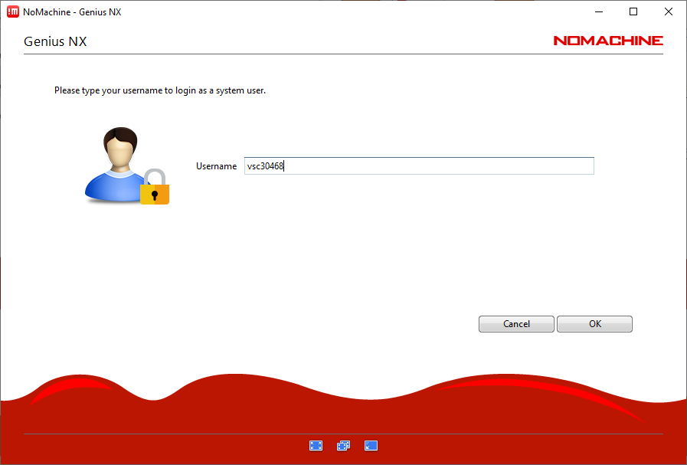
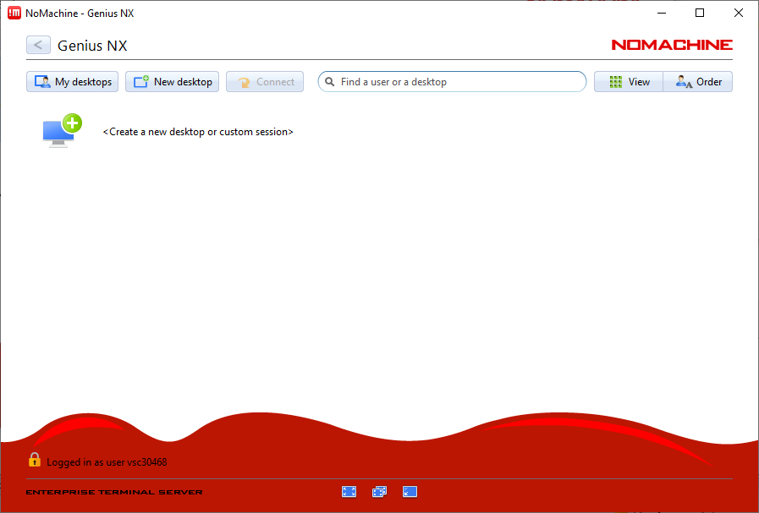
Setup NX
First open putty connection to open firewall or go to firewall.vscentrum.be for further authentication
9
11
10
52

Slide 53
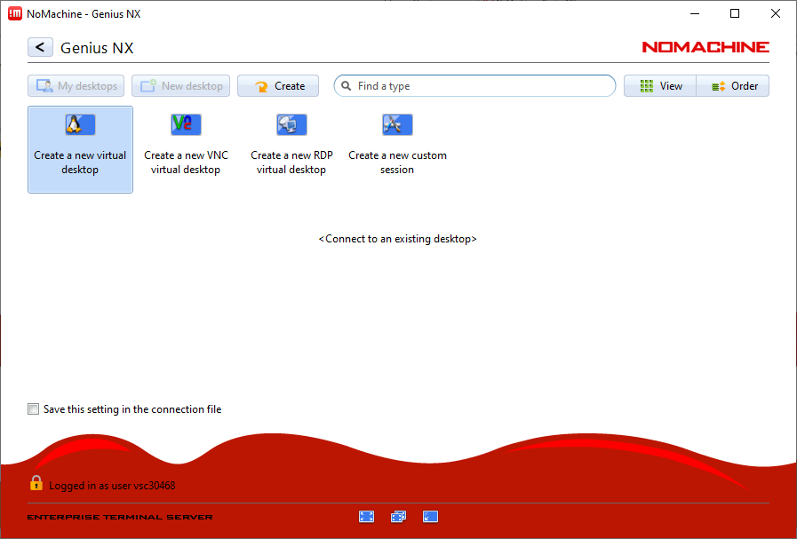
Setup NX
12
53

Slide 54
File Transfer with FileZilla

Slide 55




File transfer
Local Files
VSC Account
Application | OS
FileZilla | Windows, Linux, Mac
WinSCP | Windows
rsync, scp | Linux, Mac
Globus | Window, Linux, Mac
55

Slide 56
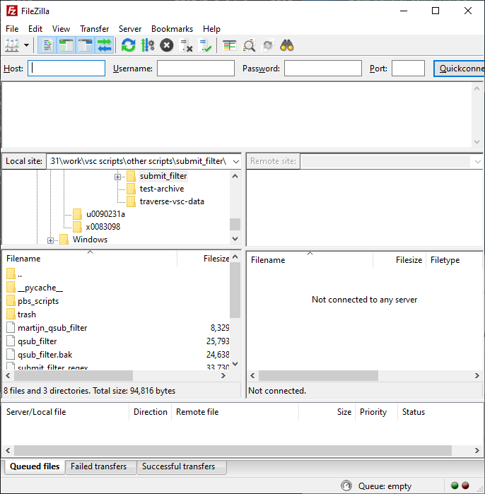
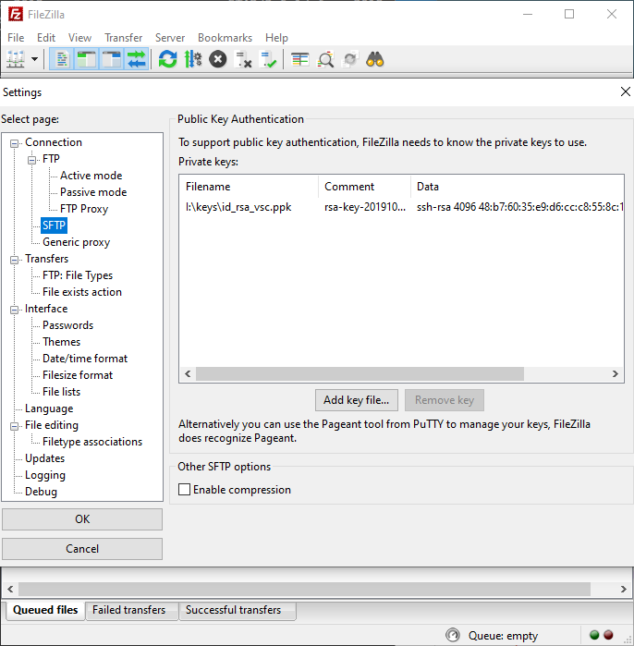
File transfer
1
Edit -> Settings
2
4
3
56

Slide 57
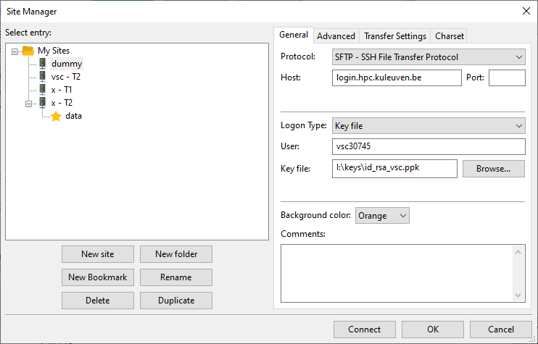
First open putty connection to open firewall or go to firewall.vscentrum.be for further authentication
File transfer
6
7
8
5
9
57

Slide 58
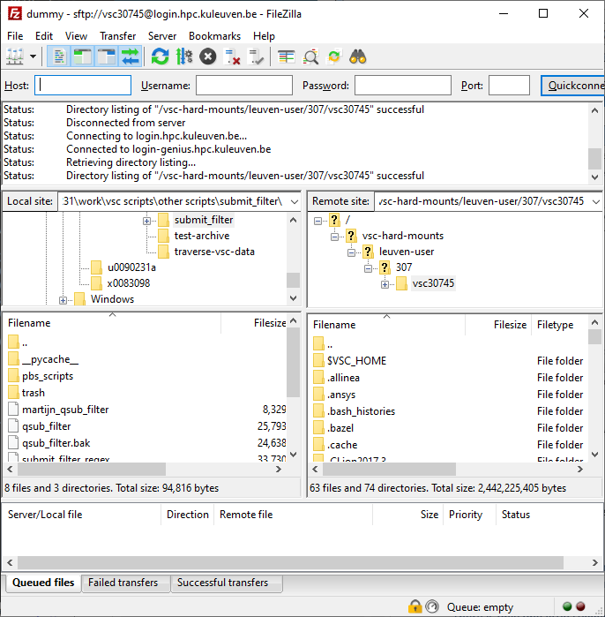
For convenience, you’d better bookmark your data and scratch folders!
Instead, go to your $VSC_DATA folder, e.g. /data/leuven/399/vsc39934
Your local machine (e.g. laptop)
Your VSC storage (e.g. $VSC_DATA, $VSC_SCRATCH). Note: by default you arrive at your own $VSC_HOME. Copy nothing there!
58

Slide 59
Open Ondemand

Slide 60

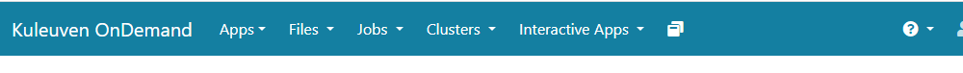
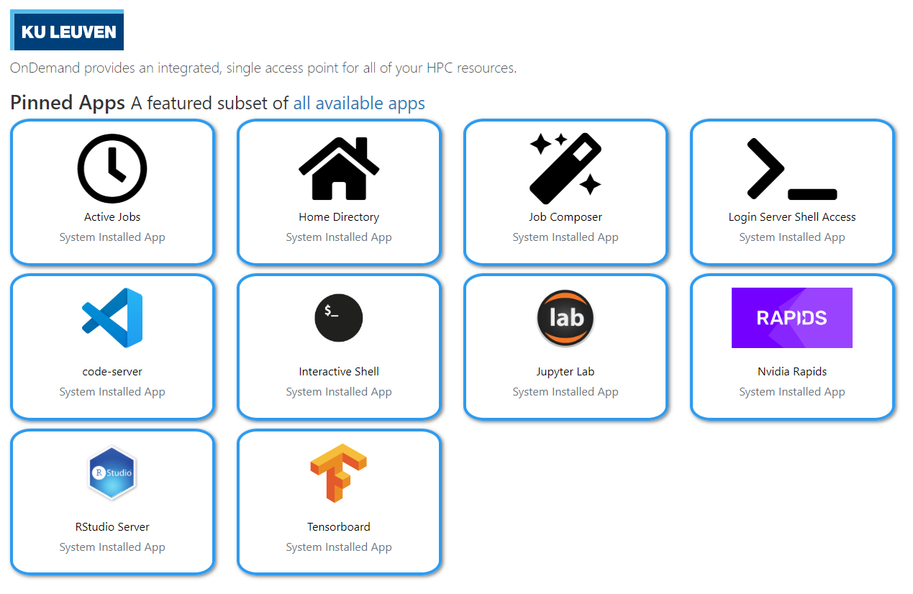
Open OnDemand
Access wICE via web browser
https://ondemand.hpc.kuleuven.be
Login via KULeuven MFA
File browser
Interactive apps + integrated shell
Create, start and monitor jobs
Develop, compile and test your code
VSCode editor
Jupyter Lab, RStudio and Tensorboard
60

Slide 61
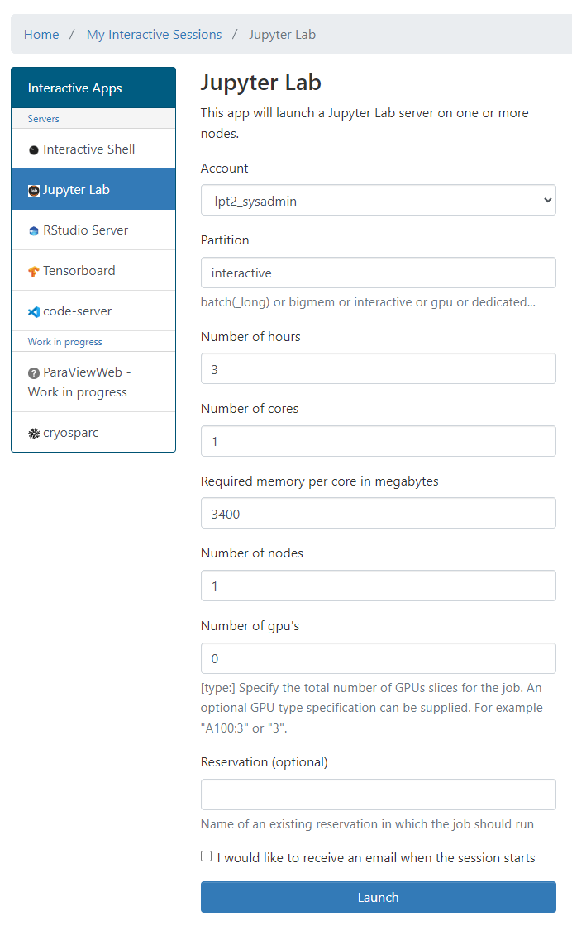
Open OnDemand
E.g. to start a Jupyter Notebook
Pick a valid Slurm credit account
Default partition: batch interactive: Max 8 cores, 1 GPU, 16 hr
Default resources: 1 core, 1 hour, 3400MB RAM, no GPU
(At the moment) you cannot use scratch and staging
lp_myproject
61

Slide 62
Software Stack

Slide 63
Software: Available Modules
OS: Rocky Linux 8.x
Toolchains:
Intel (icc, icpc, ifort; Intel MPI; Intel MKL)
FOSS (gcc, g++, gfortran; OpenMPI; ScaLAPACK, OpenBLAS, FFTW)
Toolchain year on Genius from 2018a; on wICE from 2021a
Note: Never mix FOSS and Intel compilers (gives dependency conflict)
Command | Remark
module av | List all installed modules
module av Python | List all Python-related modules
module spider Python | Get more info
module load Python/3.6.4-intel-2018a | Load a specific module
module list | List all loaded modules and their dependencies
module unload Python/3.6.4-intel-2018a | Unload a module (but dependencies still stay)
module purge | Remove all modules from your work session

Slide 64
Software: Your Specific Needs
You can always install your desired software in your $VSC_DATA Use Intel or FOSS toolchains
Compile your code on a compute node (with interactive job)
If you cannot, ask us for help
Python/R packages for AI and ML must be installed by the users themselves
Read more about Python Package Management
Read more about R Package Management

Slide 65
Starting to Compute

Slide 66







Resource Glossary
Nodes: how many compute servers to request?
Cores: how many cores per node to use?
Memory requirement: how much memory each core needs?
Partition: gpu, bigmem, superdome, amd
Walltime: how long to use resources?
Storage: how much storage (data, scratch, etc) the job needs?
Credits: how many compute credits will be consumed?

Slide 67
Serial Application (1 process on 1 core)
Single Process
One node
Multi-Core Appl. (N threads on N cores from 1 node)
Thread Group
Process Group
Distributed Appl. (many processes on
multiple cores/nodes)

Slide 68
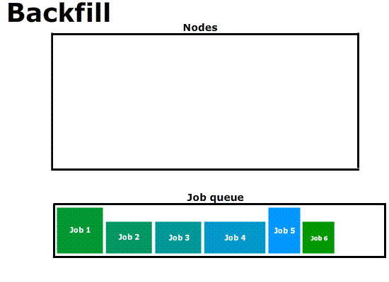
cores
time

Slide 69



Interactive Job
Compute nodes
Login node
srun …
Batch Job
Compute nodes
Login node
sbatch script.slurm

Slide 70
Interactive Job on wICE
Request interactive job
Project Name for Compute Credits
For interactive jobs
Target cluster
$ srun --account=<project name> --partition=interactive –-clusters=wice \ --nodes=1 --time=01:00:00 --pty bash -l
-
Number of tasks
Max. Runtime
Interpret with Bash
Remark
Specifying <project name> for credits is mandatory, e.g.: –A lp_hpcinfo
Implicit defaults for an interactive job on wICE are: -n 1, -t 01:00:00, --mem-per-cpu=2000M

Slide 71
Jobs: Slurm submit options
SLURM | Remarks
--nodes=X --ntasks-per-node=Y --ntasks=X*Y --ntasks=X --cpus-per-task=Y | or or (e.g. Hybrid MPI + OpenMP)
--partition=<partition_name> | Default: "batch" partition
--mem-per-cpu=<XG> | Minimum memory per core
--time=<dd-hh:mm:ss>
--job-name=<job_name>
--output=<file_template> | output
--error=<file_template> | Default: same as stdout
--mail-type=FAIL,BEGIN,END
--mail-user=<mailaddress>
--export=<ALL,key=value> | Additional variables to pass to job
--account=<account_name> | Mandatory (credits)
71

Slide 72
Argument Shorthands
Shorthand | Full Argument | Meaning
-A | --account | Slurm account name
-a | --array | Job array range
-M | --clusters | Machine or cluster name
-c | --cpus-per-task | Num cores per task (default=1)
-d | --dependency | Job dependency (after, afterok, afterany, …)
-I | --input | STDIN filename
-e | --error | STDERR filename
-o | --output | STDOUT filename
-t | --time | Maximum walltime
-N | --nodes | Minimum num nodes
-n | --ntasks | Maximum num tasks
-p | --partition | Partition name
Some (not all) of the sbatch, srun and salloc command line arguments have shorthands

Slide 73

Jobs: Defaults
PBS (on Genius)
If no explicit resources are given your job will start…
with 1 node 1 core,
with walltime of 1hr
in batch partition
jobs with no cluster given start on Genius cluster (and get job-id starting with number 5)

Slide 74
Interactive Jobs
Interactive job: 1 core for 1 hour (default) $ srun --clusters=wice --account=lp_hpcinfo --pty /bin/bash -l
Interactive job with X-forwarding $ srun --clusters=wice --account=lp_hpcinfo –x11 --pty /bin/bash -l
Request fraction of a node from interactive partition $ srun --clusters=wice --account=lp_hpcinfo --nodes=1 --ntasks=4 \ --partition=interactive --pty /bin/bash –l
Request a GPU accelerator $ srun --clusters=wice --account=lp_hpcinfo --nodes=1 --ntasks=18 \ --partition=gpu --gpus-per-node=1 --pty /bin/bash -l

Slide 75
Example Slurm Job Script
jobscript.slurm
#!/bin/bash –l
#SBATCH --clusters=wice #SBATCH --account=lp_hpcinfo #SBATCH --nodes=1 #SBATCH --ntasks=4 #SBATCH --mem-per-cpu=4G #SBATCH --job-name=hpc_workflow #SBATCH --mail-type=BEGIN,END,FAIL #SBATCH --mail-user=my.name@kuleuven.be
module load intel/2021a module load Python/3.9.5-GCCcore-10.3.0
which python3
cd $VSC_SCRATCH/projects/simulations
cp –r $VSC_DATA/input_data .
python modelling.py
cp –r output_data $VSC_DATA
rm –rf ./input_data ./output_data
Shebang
Resource List
Module load(s)
Move data
Execute commands
Move data
75

Slide 76
Job Script
Batch Workload
#!/bin/bash -l
…
Submit the job to the batch server
Receive a unique JobID
Error and output files
Command Line
$ sbatch simulation.slurm
JobID
Submitted batch job 60042478 on cluster wice
stderr, stdout
$ ls *.out slurm-60042478.out

Slide 77
Output File
STDOUT + STDERR
STDERR and STDOUT are by default redirected to a single file:
slurm-<JobID>.out
Contains job info, all errors and warnings, and printouts
Always study it
Address all warnings and errors (if you can)
Typical error examples …
$ ls slurm-*.out slurm-60042478.out
Out of Memory
slurmstepd: error: Detected 1 oom-kill event(s). Some of your processes may have been killed by the cgroup out-of-memory handler.
Short Walltime
slurmstepd: error: *** JOB 60042478 ON s28c11n2 CANCELLED AT 2023-02-08T10:03:43 DUE TO TIME LIMIT ***
Low Disk Space
IOError: [Errno 122] Disk quota exceeded

Slide 78
Output File
Output File
SLURM_JOB_ID: 60033947
SLURM_JOB_USER: vscXXXXX
SLURM_JOB_ACCOUNT: lp_wice_pilot
SLURM_JOB_NAME: testjob
SLURM_CLUSTER_NAME: wice
SLURM_JOB_PARTITION: batch
SLURM_NNODES: 1
SLURM_NODELIST: m28c30n4
SLURM_JOB_CPUS_PER_NODE: 72
Date: Tue Jan 10 17:02:04 CET 2023
Walltime: 00-01:00:00
==================================
/apps/leuven/rocky8/icelake/2021a/softwar
e/intel-compilers/2021.2.0/compile
r/2021.2.0/linux/bin/intel64/icc
cp: cannot stat '/apps/leuven/trai
ning/test': No such file ordirecto
ry
Hello World
Always created
slurm-<job_id>.out
Contains all standard output and error (instead of screen)
Always study it
Standard Output and Error channels can be redirected to other files: #SBATCH --output … #SBATCH --error …
Resource Summary
Stdout
stdout
$ ls slurm-*.out slurm-60041238.out

Slide 79
Output File
Example
$ scontrol show job --clusters=wice 60049330
JobId=60049330 JobName=f70.slurm
UserId=vsc3…(253…) GroupId=vsc3…(253…) Account=lp_my_project QOS=lp_my_project
JobState=PENDING Reason=QOSGrpBillingMinutes SubmitTime=2023-02-16T00:24:58 EligibleTime=2023-02-16T00:24:58 Partition=batch NodeList= NumNodes=4-4 NumCPUs=288 NumTasks=288 CPUs/Task=1
TRES=cpu=288,mem=979200M,node=4,billing=733 MinCPUsNode=72 MinMemoryCPU=3400M WorkDir=/vsc-hard-mounts/leuven-data/3../vsc3…/Odonate_SOM
StdErr=/vsc-hard-mounts/leuven-data/3../vsc3…/Odonate_SOM/slurm-60049330.out
StdIn=/dev/null
StdOut=/vsc-hard-mounts/leuven-data/3../vsc3…/Odonate_SOM/slurm-60049330.out
Diagnosis
Why is my job in pending/hold state? Check out the “Reason” on Slurm docs: https://slurm.schedmd.com/resource_limits.html

Slide 80
Other Partitions on wICE
GPU
Big Memory
#SBATCH --partition=gpu #SBATCH --nodes=1 #SBATCH --ntasks=18 #SBATCH --gpus-per-node=1
#SBATCH --partition=bigmem #SBATCH --nodes=1 #SBATCH --tasks-per-node=72 #SBATCH --mem-per-cpu=28000M

Slide 81
Managing & Monitoring Jobs
Command | Purpose
sbatch ... | Submit a batch job
srun ... | Submit an interactive job
scancel --cluster=wice <JobID> | Cancel a specific pending or running job
scontrol show job --cluster=wice <JobID> slurm_jobinfo <JobID> | Detailed job info (very useful to diagnose issues)
squeue --cluster=wice –long | Status of all recent jobs
squeue --cluster=wice –start | Give a rough estimate of start time
sinfo --cluster=wice | Info about the state of available partitions and nodes
sacct --cluster=wice --batch --job <JobID> | Show minimal info about a queue or partition
slurmtop --cluster=wice | Overview of the cluster

Slide 82
Interactive Partition
Accessible via command line and Open OnDemand
To quickly compile, test, debug your (parallel) application
To pre-/post-process your data and make visualizations
Short queue time
5 dedicated nodes on wICE:
64 cores per node
1 GPU (=7 GPU instances)
512 GB memory
Max resource per user: 8 cores, 1 GPU instance, 16 hour walltime
Interactive Job
$ srun --account=lp_myproject --clusters=wice \
--partition=interactive --nodes=1 --time=16:00:00 \
--gpus-per-node=1 --pty bash -l

Slide 83
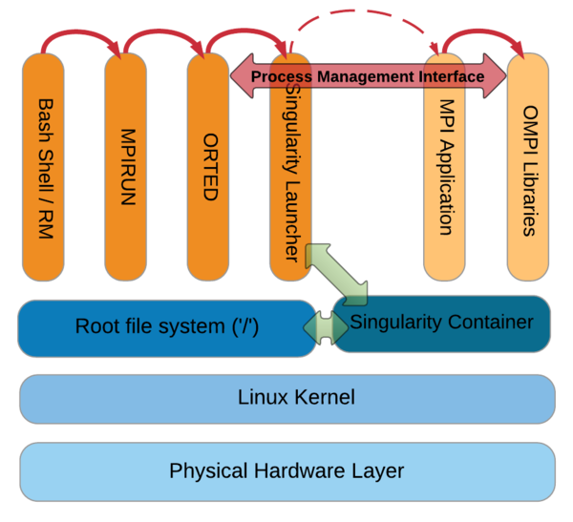
Singularity Containers
What?
Self-contained OS & software & data
Why?
fully resolved dependency chains
portable workflow
How?
You create the image
Run it on Genius/wICE
MPI/OpenMP is supported
#!/bin/bash -l
#SBATCH --time=30:00 #SBATCH --nodes=2 #SBATCH --ntasks=72 #SBATCH --clusters=wice #SBATCH --account=lp_hpcinfo
singularity run Project.simg ./model.exe
script.slurm

Slide 84
Credits
Credits card concept:
Pre-authorization: holding the balance as unavailable until the merchant clears the transaction
Balance to be held as unavailable: based on requested resourced (walltime, nodes)
Actual charge based on what was really used: used walltime (you pay only what you use, e.g. when job crashes) See output file.
How to check the rates? Check the HPC service catalogue
How to check available credits? $ sam-balance
Did the new credits arrive? $ sam-list-allocations

Slide 85
Credits Pricing
Cluster / Partition | Credits/hr
Genius Cascadelake | 11.3
Genius Cascadelake 8 GPUs | 40
Genius Skylake 4 GPUs | 20
Genius Skylake BigMem | 12
Genius Skylake | 10
Genius / Superdome | 10
Genius / AMD nodes | 10
wICE / Thinnode | 10,99
wICE Bigmem | 19
wICE / 1 GPU | 11,25
wICE 4GPUs | 45
wICE Interactive | -
You pay as you go!
For academic projects: 1000k credits = 3.5 EUR
Credits needed for a job: #credits (k) = Walltime (hr) × #nodes × Factor
For shared nodes, you pay a fraction of the costs, based on the --ntasks-per-node specified

Slide 86
How to manage credits?
Command | Purpose
sam-balance | List active projects and available credits
sam-list-allocations | List the validity dates of different projects/allocations
sam-list-usagerecords | List current charge rates for different nodes
sam-statement --account=<account-name> | Job statements from an account

Slide 87
Conda Package Management: Python and R

Slide 88
https://docs.vscentrum.be/en/latest/software/python_package_management.html?highlight=iniconda#install-python-packages-using-conda
Conda on wICE
Good practice would be 2 separate paths of conda installations for each cluster.
Beginning of the slurm script matters. Use #!/bin/bash –l not #!/bin/bash to load the env properly.
Universal .bashrc
case ${VSC_INSTITUTE_CLUSTER} in
genius)
export PATH="${VSC_DATA}/miniconda3/bin:${PATH}"
;;
wice)
export PATH="${VSC_DATA}/miniconda3-wice/bin:${PATH}"
;;
esac

Slide 89
Worker Framework

Slide 90
Sequential…
A shell program consists of a sequential list of commands -> bash script on HPC cluster will run sequentially
Socket 0
Socket 1
#!/bin/bash
My_program 1
My_program 2
My_program 3
…
…
My_program 20
L3
L3
DDR
0
5
10
15
DDR
DDR
1
6
QPI
11
16
DDR
2
L1
L2
QPI
17
core0
7
12
DDR
DDR
3
8
13
18
DDR
4
9
14
19
DDR
IB
I/O
90

Slide 91
Sequential…
A shell program consists of a sequential list of commands -> bash script on HPC cluster will run sequentially
Socket 0
Socket 1
#!/bin/bash
My_program 1
My_program 2
My_program 3
…
…
My_program 20
L3
L3
DDR
0
5
10
15
DDR
DDR
1
6
QPI
11
16
DDR
2
L1
L2
QPI
17
core0
7
12
DDR
DDR
3
8
13
18
DDR
4
9
14
19
DDR
IB
I/O
Use worker on the cluster
91

Slide 92
Parallel Computing
Talk to us about worker framework
Lucky you!
Serial:
one program, on one core
“Embarrassingly parallel” problems:
lots of runs of one program, with different parameters
Problems that require “real” parallel algorithms
OpenMP
MPI : Message Passing Interface

Slide 93
Use case: parameter exploration
temperature | pressure | humidity
293.0 | 1.0e05 | 87
… | … | …
313.0 | 1.3e05 | 75
#!/bin/bash –l
#SBATCH --cluster=wice
#SBATCH --nodes=1
#SBATCH --ntasks-per-node=1 #SBATCH --time=10:00
#SBATCH --account=lp_myproject
cd $SLURM_SUBMIT_DIR weather –p 1.0e05 –t 293.0 –h 87
job_001.slurm
#!/bin/bash –l
#SBATCH --cluster=wice
#SBATCH --nodes=1
#SBATCH --ntasks-per-node=1 #SBATCH --time=10:00
#SBATCH --account=lp_myproject
cd $SLURM_SUBMIT_DIR weather –p 1.0e05 –t 293.0 –h 87
job_030.slurm
Many single core computations
#!/bin/bash –l
#SBATCH --cluster=wice
#SBATCH --nodes=1
#SBATCH --ntasks-per-node=1 #SBATCH --time=10:00
#SBATCH --account=lp_myproject
cd $SLURM_SUBMIT_DIR weather –p 1.0e05 –t 293.0 –h 87
job_600.slurm
…
…
93

Slide 94
Solution: worker with -data
temperature | pressure | humidity
293.0 | 1.0e05 | 87
… | … | …
313.0 | 1.3e05 | 75
data.csv
#!/bin/bash –l
#SBATCH --cluster=wice
#SBATCH --nodes=2
#SBATCH --ntasks-per-node=72 #SBATCH --time=01:00:00
#SBATCH --account=lp_hpcinfo
cd $SLURM_SUBMIT_DIR weather -p $pressure –t $temperature –h $humidity
job.slurm
From Genius login node: $ module purge
$ module use /apps/leuven/rocky8/skylake/2021a/modules/all
$ module load worker/1.6.12-intel-2021a-wice $ wsub –data data.csv –batch job.slurm
#From wICE interactive session: $ module --force purge
$ module use /apps/leuven/rocky8/icelake/2021a/modules/all
$ module load worker/1.6.12-foss-2021a $ wsub –data data.csv –batch job.slurm
94

Slide 95

Data exploration: steps
Write slurm script with parameters
Create Excel sheet with data
Convert to CSV format
Submit with wsub
walltime is time to complete all work items
$${walltime}_{job}≥\frac{N∙{walltime}_{work item}}{nodes∙ntasks\text{−}per\text{−}node}$$

Slide 96






Worker processing: informally
slave₁
slave queries for work
/
master sends work
/
slave notifies on success/failure, queries
for more work
master
…
Done!
master sends stop
/
slave_{S}
batch.sh.worker

Slide 97


How to use worker well?
Many work items, i.e., #work items/#proc >> 1
time(work item) > 1 minute
Work item is not multithreaded
Work item is multithreaded
will work, but user must be careful to request the right resources
Use –threaded <n> flag with wsub
Here be dragons: licensing!
Here be Dragons

Slide 98
Worker & multithreading
Some software uses multithreading automatically, e.g.,
R
Matlab
Will use as many threads as there are cores, regardless of system load
36 cores/node
36 work items/node
72 × 72 threads/node
Oversubscription: very inefficient!!!

Slide 99
Controlling number of threads
#!/bin/bash -l
#SBATCH –account=lp_myproject
#SBATCH --cluster=wice
#SBATCH --time=1:00:00
#SBATCH --nodes=2
#SBATCH --ntasks-per-node=72
module load R
cd $SLURM_SUBMIT_DIR
export OMP_NUM_THREADS=1
Rscript program $a $b
program_pe.slurm
R, most of the time: OMP_NUM_THREADS=1
Matlab
Use maxNumCompThreads(1) function call
Use compiler flag: mcc –singleCompThread …
99

Slide 100
Help on worker
See documentation http://worker.readthedocs.io/
Each command has help, use –h
All resources have to be specified inside slurm script
wresume does not work yet. Only wsub is so far supported
-master flag does not work yet

Slide 101
Submitting worker jobs
From wICE (Interactive) Node
$ module av worker
---------------- /apps/leuven/rocky8/icelake/2021a/modules/all ----------
worker/1.6.12-foss-2021a
From Genius Login Node
$ module av worker
--------------- /apps/leuven/rocky8/skylake/2021a/modules/all ----------
worker/1.6.12-foss-2021a-wice worker/1.6.12-intel-2021a (D)
worker/1.6.12-foss-2021a

Slide 102
Submitting worker jobs
Let us use one of the worker examples: https://github.com/gjbex/worker/tree/development_slurm/examples/bash_example
#!/bin/bash –l #SBATCH --nodes=1 #SBATCH --ntasks-per-node=27 #SBATCH --time=00:30:00 #SBATCH --account=lpt2_sysadmin #SBATCH --clusters=wice cd $SLURM_SUBMIT_DIR alphabet.sh $letter $counter
alp.slurm
letter,counter
a,1
b,2
c,3
d,4
e,5
f,6
....
alpha.csv

Slide 103
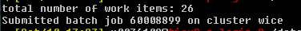
Submitting worker jobs
From Genius
#!/bin/bash -l
module purge
module use /apps/leuven/rocky8/skylake/2021a/modules/all
module load worker/1.6.12-foss-2021a-wice
wsub -batch alp.slurm -data alpha.csv

Slide 104
Submitting worker jobs
From interactive job on wICE
#!/bin/bash -l
module --force purge
module use /apps/leuven/rocky8/icelake/2021a/modules/all
module load worker/1.6.12-foss-2021a
wsub -batch alp.slurm -data alpha.csv

Slide 105
Demo: Test for yourself

Slide 106
Demo/test yourself
Request membership to lp_hpcinfo group (account.vscentrum.be)
Login with putty
Filetransfer with Filezilla
Login with NX
Check disk quota
Check the credits
Check/load/list/unload/purge module

Slide 107
Demo/test yourself
Copy intro training files /apps/leuven/training/HPC_intro/ to your $VSC_DATA
Submit cpujob to the cluster
List all your jobs squeue -M wice
Check the information about the cpujob slurm_jobinfo -M wice <job_ID>
Modify the mpi.slurm script to request 1 node, 72 cores for 30 minutes and get the notification about job start/end by e-mail
Check the status of all the jobs

Slide 108
Demo - monitoring
Submit an interactive job
Run your program on a compute node
Open a new terminal and ssh to a compute node
Check the resources usage (top)
Submit a batch GPU job
While the job is running get the information about the node slurm_jobinfo...
and check usage of resources on the node ssh, top, nvidia-smi

Slide 109
Demo - Conda installation
Install miniconda in your $VSC_DATA directory
$ wget https://repo.continuum.io/miniconda/Miniconda3-latest-Linux-x86_64.sh
$ bash Miniconda3-latest-Linux-x86_64.sh -b -p $VSC_DATA/miniconda3
Add a PATH to conda:
$ export PATH="${VSC_DATA}/miniconda3/bin:${PATH}"
Check if conda in added to your $PATH ($ which conda)
Add it to $PATH in your .bashrc
$ echo 'export PATH="${VSC_DATA}/miniconda3/bin:${PATH}" ' >> .bashrc

Slide 110
Demo - Conda usage
Create a conda environment including Jupyter
$ conda create -n science jupyter numpy scipy
Activate this environment
$ source activate science
Add matplotlib package to this environment
$ conda install matplotlib
Return to original environment
$ conda deactivate

Slide 111
Demo - worker
Copy intro training files (/apps/leuven/training/worker/) to your $VSC_DATA
Go to exercise1 directory
Submit worker job
Check the output file

Slide 112
Command | Purpose
$ sbatch ... | Submit a batch job
$ srun ... | Submit an interactive job
$ scancel --cluster=wice <JobID> | Cancel a specific pending or running job
$ scontrol show job --clusters=wice <JobID> $ slurm_jobinfo <JobID> | Detailed job info (very useful to diagnose issues)
$ squeue --clusters=wice --long | Status of all recent jobs
$ squeue --clusters=wice --start | Give a rough estimate of start time
$ sinfo --clusters=wice | Info about the state of available partitions and nodes
$ sacct --clusters=wice --batch --job <JobID> | Show minimal info about a queue or partition (-p)
$ slurmtop $ scontrol --clusters=wice show node <hostname> | Overview of the cluster Get detailed information about the status of a node
$ sam-balance | Overview of all your available credit projects
$ sam-list-allocations | Detailed overview of your credit allocation history

Slide 113
VSC
Questions
Helpdesk: hpcinfo@kuleuven.be or https://admin.kuleuven.be/icts/HPCinfo_form/HPC-info-formulier
VSC web site: http://www.vscentrum.be/
VSC documentation: https://docs.vscentrum.be/en/latest/
VSC agenda: training sessions, events
Systems status page: http://status.vscentrum.be

